Slide 1
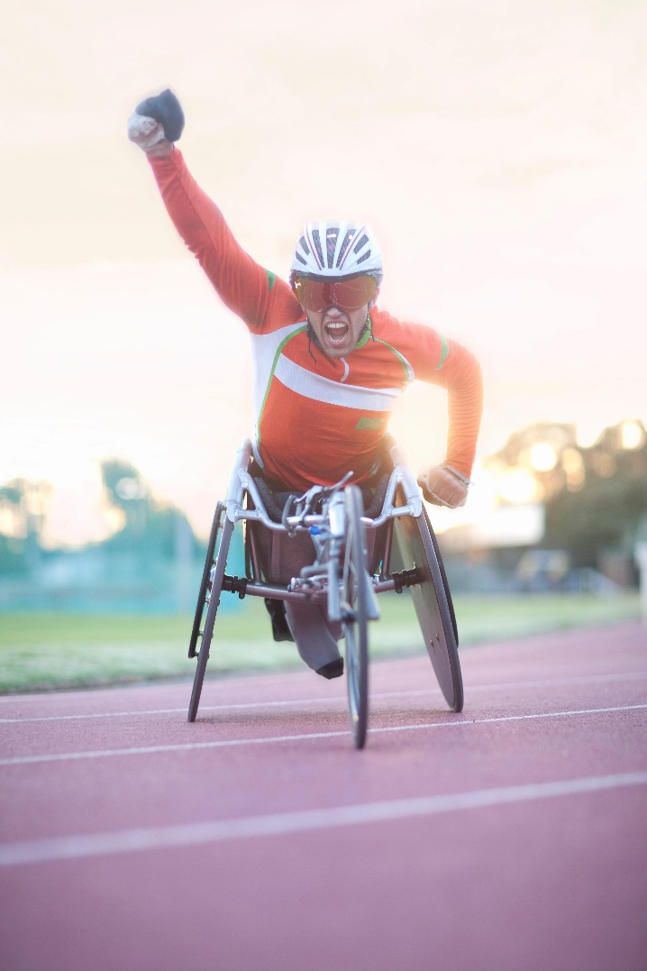

Slide 2
What is ____________?
a need or desire that energizes and directs behavior

Slide 3
From which perspectives have psychologists viewed motivation?
_______
theory
_______-_________ theory
________
theory
_________ of _________

Slide 4
What is an __________?
a complex behavior that
is rigidly patterned throughout a
species and is unlearned

Slide 5
What is ______________theory?
To qualify as an instinct, a complex behavior must have a fixed pattern throughout a species and be unlearned.
Instinct theory views our instincts as the source of our motivations.
Instinct theory states that the motivation to survive is the most important motivation and the innate behaviors that aid survival drive our motivations…this sounds quite a lot like evolutionary theory.

Slide 6
How do physiological needs create a ________?
Physiological needs (such as for food or
water) create an aroused, motivated state—
a drive (such as hunger or thirst)—that pushes
us to behave in a way that reduces the need and
returns the body to ___________________.

Slide 7
What is______________________theory?
the idea that a physiological need creates
an aroused state (a drive) that motivates an organism to satisfy the need and restore the body to homeostasis, or balance

Slide 8
How is behavior pulled by ______________?
Not only are we pushed by our need to reduce physiological drives, we also are pulled by incentives— positive or negative environmental stimuli that lure or repel us.

Slide 9
What is the ___________________ law?
Two early twentieth-century psychologists studied the
relationship of arousal to performance and identified the
Yerkes-Dodson law: moderate arousal leads to optimal performance. (Yerkes & Dodson, 1908)

Slide 10
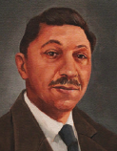
What is Abraham’s ____________’s theory of motivation?
Abraham Maslow
theorized that human needs are hierarchical….some have priority over others.
Abraham _________
1908-1970

Slide 11
What is a _________ of _________?
Maslow’s hierarchy of needs begins at the base with physiological needs that must first be satisfied before higher level safety needs and then psychological needs are addressed.

Slide 12
Two portions of the hypothalamus that control appetite.
____________ hypothalamus (LH)
________________
hypothalamus (VMH)
Stimulation of this structure in the hypothalamus stimulates hunger.
Lesioning (surgically removing) inhibits hunger signals.
Stimulation of this structure in the hypothalamus inhibits hunger.
Lesioning inhibits satiety(full) signals.

Slide 13
What are five appetite hormones?
_________: decreases appetite
__________:
decreases appetite
________: decreases appetite
_________: increases appetite
__________: increases appetite

Slide 14
What is the ____ ____________?
the point (weight) at which your
“weight thermostat” may be set (fixed)
When your body falls below this weight, increased hunger and a lowered metabolic rate may
combine to restore lost weight.

Slide 15
What are the two sex hormones?
_______________
______________
Both males and females have testosterone, but the additional testosterone in males stimulates the growth of the male sex organs during the fetal period and the development of the male
sex characteristics during puberty.
Estrogen is a sex hormone that contribute to female sex characteristics and is secreted in greater amounts by females than by males.
Estrogen levels peak during ovulation.

Slide 16
What is the sexual response cycle?
the
four stages of sexual responding
described by William _________ and
Virginia __________ in 1966
Phase One: ________
Phase Two:
__________
Phase Three:
__________
Phase Four: __________

Slide 17
What is _____________ motivation?
a desire for significant
accomplishment, for mastery of
skills or ideas, for control, and for
attaining a high standard

Slide 18
What is _________?
a response of the whole organism, involving physiological arousal,
expressive behaviors, and
conscious experience

Slide 19
What is the _____________ theory of emotion?
the theory that our experience of emotion is
our awareness of our physiological
responses to an emotion-arousing stimulus:
stimulus leads to arousal which leads to emotion
“We feel sorry because we cry, angry because we strike, afraid because we tremble.”
(William James, 1890, p. 1066)

Slide 20
How did Walter Cannon disagree with the James-Lange theory of emotion?
Harvard physiologist Walter Cannon and his graduate student Philip Bard disagreed with the
James-Lange theory.
They asked:
“Does a racing heart signal fear or anger or love?”
The body’s responses—heart rate, perspiration,
and body temperature—are too similar, and they change too slowly, to ________ the different emotions.

Slide 21
What is the ____________ thalamic theory of emotion?
the theory that an emotion-arousing
stimulus simultaneously triggers
(1) physiological responses and
(2) the subjective experience of
emotion

Slide 22
How do the two theories differ?
____________ theory
__________ theory
Physiological responses occur first and are the cause of emotions.
The emotional and the physical response occur simultaneously - one is not dependent upon the other.

Slide 23
How do thinking and feeling interact?
The James-Lange theory and the Cannon-Bard theory both take into account physiological responses and the interplay with emotion.
But how does ________ factor in to the theory of emotion?
Stanley _________ and Jerome ________ demonstrated that how we appraise (interpret) our experiences also matters.

Slide 24
What is the Schachter-Singer _______________ theory of emotion?
Our physical reactions and our thoughts (perceptions, memories, and interpretations) together
create emotion.
In Schachter and Singer’s _________________, emotions have two ingredients:
physical arousal and cognitive appraisal.
An emotional experience, they argued, requires a conscious interpretation of arousal.

Slide 25
So, does _____________ matter?
This discovery—that a stirred-up state can be experienced as one emotion or another, depending on how we interpret and label it—has been replicated in dozens of experiments and continues to influence modern emotion research.
(MacCormack & Lindquist, 2016; Reisenzein, 1983; Sinclair et al., 1994)

Slide 26
Does __________ have to precede emotion?
Must we always interpret our arousal before
we can experience an emotion?
Psychologist Robert _____________ didn’t think so.
He contended that we actually have many emotional reactions apart from, or even before, our
conscious interpretation of a situation.

Slide 27
How do the Schachter-Singer and Zajonc-LeDoux theories of emotion compare?
_________________
_______________
Our appraisal and labeling of events also determine our emotional responses.
Some emotional responses
are immediate, before any
conscious appraisal.

Slide 28
What did ____________ conclude?
The appraisal may be effortless and we may not be conscious of it, but it is still a mental function.
To know whether a stimulus is good or bad, the brain must have some idea of what it is.
(Storbeck et al., 2006)
Lazarus proposed that emotions arise when we appraise an event as harmless or dangerous.
For instance, we appraise the sound of the rustling bushes as the presence of a threat.
Later, we realize that it was “just the wind.”

Slide 29
How effective are __________ in using body states to detect lies?
Polygraphs measure emotion-linked autonomic arousal, as reflected in changed breathing,
heart rate, and perspiration.
Can these results be used to detect lies?

Slide 30
What is a _________smile?
Raised cheeks and activated muscles
under the eyes suggest a natural smile, called a Duchenne smile.
(in honor of the
French physician who described it).

Slide 31
Do facial expressions have different meanings in different cultures?
Two investigative teams showed photographs of various facial expressions to people in different parts of the world and asked them to guess the emotion.
(____________________1994, 2016; Izard, 1977, 1994)

Slide 32
Do all cultures express the same degree of emotion?
Compared with their counterparts in China, where calmness is emphasized, European-American leaders
follow different _________ ______—they express excited smiles six times more frequently in their official photos.
(Tsai et al., 2006, 2016)

Slide 33
What were the results of this research?
Kazuo Mori and Hideko Mori’s results confirmed the ___________ _____________effect; the tendency of facial muscle states to trigger corresponding feelings such as fear, anger, or happiness.
Most students reported feeling more happy than sad when their cheeks were raised upward.
Most students reported feeling more sad than happy when their cheeks were pulled downward

Slide 34
What is the ___________ feedback effect?
the tendency of behavior to influence
our own and others’ thoughts,
feelings, and actions
For instance, walk for a few minutes with
short, shuffling steps, keeping your eyes downcast. Now walk around taking long strides, with your arms swinging and your eyes looking straight ahead.
Can you feel your mood shift?
Going through the motions awakens the emotions.

Slide 35
What is _________?
the process by which we
perceive and respond to certain
events, called stressors, that
we appraise as threatening or
challenging

Slide 36
How are a stressor and a stress reaction related to stress?
What is a ________?
What is a stress reaction?
What is _______?
To a psychologist, the terrifying truck ride that Ben took was a stressor.
Ben’s physical and emotional responses were a stress reaction.
And the process by which Ben related to the threat was stress.

Slide 37
What are three main categories of stress?
1
__________________
2
___________ __________changes
3
__________ hassles

Slide 38
How do we respond and adapt to stress?
When alerted by any of a number of brain pathways, the sympathetic nervous system arouses us, preparing the body for the adaptive response Walter Cannon called ______________. It increases heart rate and respiration, diverts blood from digestion to the skeletal muscles, dulls feelings of pain, and releases sugar and fat from the body’s stores.

Slide 39
How do the adrenal glands work to affect stress responses?
Physiologists have identified an additional stress response system. On orders from the cerebral cortex (via the hypothalamus and pituitary gland), the outer part of the adrenal glands secretes glucocorticoid stress hormones such as cortisol.

Slide 40
What is the ____ _________ _______________(GAS)?
Canadian scientist Hans Selye’s 40 years of research on stress extended Cannon’s findings. His studies of animals’ reactions to various stressors, such as electric shock and surgery, helped make stress a major concept in both psychology and medicine.
Selye proposed that the body’s adaptive response to stress is so general that, like a single
burglar alarm, it sounds, no matter what intrudes. He named this response the general
adaptation syndrome (GAS).

Slide 41
What are the three stages of the general adaptation syndrome (GAS)?
____ ________saw the general adaptation syndrome as a three-phase process of alarm, resistance and exhaustion.

Slide 42
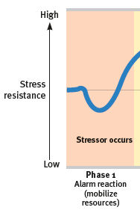
What is _________?
In Phase 1, an alarm reaction, occurs as the sympathetic nervous system is suddenly
activated.
The heart rate zooms and blood is diverted to the skeletal muscles.
Feelings of faintness of shock may occur.
Resources are mobilized, and fight/flight or freeze is activated.

Slide 43
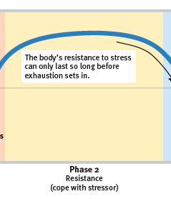
What is resistance?
During Phase 2, resistance, temperature, blood pressure, and respiration remain
high. The adrenal glands pump hormones into the bloodstream. All resources are summoned to meet the challenge.
As time passes, with no relief from stress, the body’s reserves begin to dwindle.

Slide 44
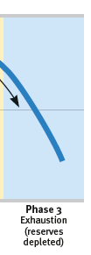
What is exhaustion?
Phase 3, exhaustion
With exhaustion, the body becomes more vulnerable to
illness or even, in extreme cases, collapse and death.

Slide 45
What is the tend-and-befriend response?
Another, found often among women, is to
give and receive support—what’s called the tend-and-befriend response.
(Lim & DeSteno, 2016; Taylor, 2006; Taylor et al., 2000)
Facing stress, men more often than women tend to withdraw socially, turn to alcohol, or become emotionally insensitive. (Bodenmann et al., 2015)
Women more often respond to
stress by nurturing and banding together.

Slide 46
What are health psychology and psychoneuroimmunology?
health psychology
psychoneuroimmunology
a subfield
of psychology that provides
psychology’s contribution to
behavioral medicine
the
study of how psychological, neural, and endocrine processes together
affect the immune system and resulting health

Slide 47
the _____ response
Four types of cells are active in searching for and destroying invaders in the body; B and T lymphocytes, macrophages and natural killer cells.

Slide 48
What follow up research was conducted by Freidman and Rosenman?
Friedman and Rosenman launched a longitudinal study of more than 3000 healthy men, aged 35 to 59.
The researchers interviewed each man for 15 minutes, noting his work and eating habits, manner of talking, and other behavior patterns.
After the interviews, the subjects were classified as having either Type A or Type B personalities.

Slide 49
What characterizes a Type ____ personality?
The subjects in Friedman and Rosenman’s study who seemed the most
reactive, competitive, hard-driving, impatient, time-conscious, super-motivated, verbally aggressive, and easily angered they called Type A.

Slide 50
What characterizes a Type _____ personality?
The roughly equal number of men in Friedman and Rosenman’s study who were
more easygoing and relaxed they called
Type B.

Slide 51
What were the findings of the longitudinal study?
Nine years later, 257 men had suffered heart attacks, and 69 percent of them were Type A.
Moreover, not one of the “pure” Type B’s—the most mellow and laid-back of their group—had suffered a heart attack.

Slide 52
What are ways to defuse anger?
______
Reduce the level of physiological arousal of anger by waiting.
“What goes up must come down.”
(C. Tavris, 1982)
find a healthy distraction or support
Calm yourself by exercising, playing an instrument, or talking it through with a friend.
________yourself
Try to move away from the situation mentally, as if you are watching
it unfold from a distance

Slide 53
Does stress cause illness?
Stress may not directly cause illness, but it does make us more vulnerable, by influencing our behaviors and our physiology.

Slide 54
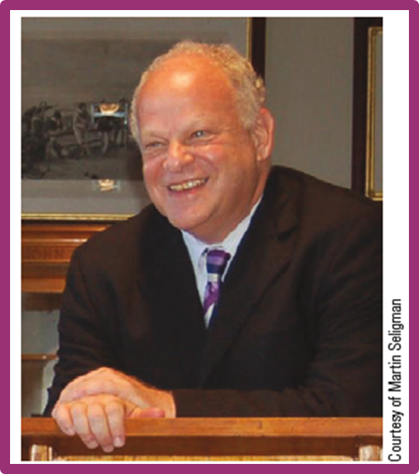
What is __________ psychology?
Psychologist Martin Seligman proposed the scientific study of human flourishing, with the goals of
discovering and promoting strengths and virtues that help individuals and communities to
thrive.
Martin Seligman
(1942- )

Slide 55
What is __________ psychology’s first pillar?
Taken together, satisfaction with the past, happiness with the present, and optimism
about the future define the positive psychology movement’s first pillar: positive well-being.
Seligman views happiness as a by-product of a pleasant, engaged, and meaningful life.

Slide 56
What is __________psychology’s second pillar?
Positive psychology is about building not just a pleasant life, says Seligman, but also a
good life that engages one’s skills, and a meaningful life that points beyond oneself.
Thus, the second pillar, positive character, focuses on exploring and enhancing creativity, courage,
compassion, integrity, self-control, leadership, wisdom, and spirituality.

Slide 57
What is positive psychology’s third pillar?
The third pillar, positive groups, communities, and cultures, seeks to foster a positive social
ecology.
This includes healthy families, communal neighborhoods, effective schools, socially
responsible media, and civil dialogue.

