Slide 1
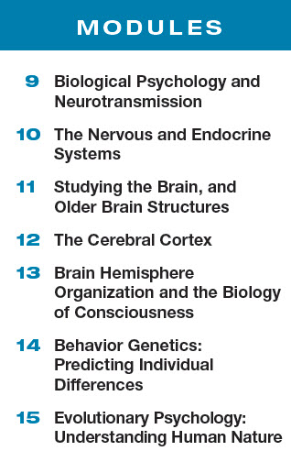
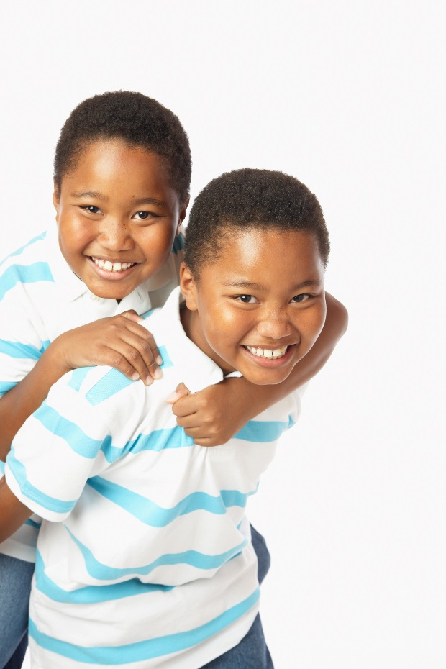
Unit 3: Biological Bases of Behavior

Slide 2
What is a ______________?
A _________ is a nerve cell that is the basic building block of the nervous system.

Slide 3
What are the parts of a neuron?

Slide 4
What are ____________?
Neurons are like queen bees;
on their own they cannot feed or sheathe themselves.
Glial cells are
worker bees;
they provide nutrients and insulating myelin, guide neural connections, and
mop up ions and neurotransmitters.
cells that support,
nourish, and protect neurons;
they also play a role in learning,
thinking, and memory

Slide 5
How is a neural impulse generated?
If the combined received chemical signals exceed a minimum ________, the neuron fires, transmitting an
electrical impulse (the ________________)
down its axon by means of a
chemistry-to-electricity process.

Slide 6
What is a ____________?
The level of stimulation
required to trigger a neural impulse.
Neurotransmitters received by the dendrites build up to initiate the action potential.

Slide 7
What is the all-or-none response?
More stimulation does not produce a more intense neural transmission.
The neuron’s reaction is an __________________. Neural firing happens at full response or not at all.
Like guns, neurons either fire or they don’t. Squeezing a trigger harder won’t make a bullet go faster.

Slide 8
Neural impulses can be excitatory or inhibitory.
____________ signal
_________signal
Like the gas pedal
on the car.
Excitatory neurotransmitter signals trigger action.
Like the brake pedal
on the car.
Inhibitory neurotransmitter signals depress action.
When the excitatory impulses outnumber the inhibitory impulses, the threshold has been reached and an action potential occurs.

Slide 9
What is the resting state of an axon?
Prior to beginning the action potential, the outside of an axon’s membrane has mostly positively charged sodium (Na⁺) ions and the interior contains negatively charged proteins and a small amount of positively charged potassium (K⁺) ions.
This creates a slightly negative charge and at this point, the neuron is said to be in the
_________________, or polarized.

Slide 10
What happens after the action potential moves to the end of the neuron??
Neurons need short breaks.
During a resting pause called
the ________________,
subsequent action potentials cannot occur
until the axon returns to
its resting state.
Then the neuron can fire again.

Slide 11
Let’s review three key terms in the process…
___________-: the resting state of the neuron, charge is more positive outside the membrane and more negative inside.
___________: the action potential; the rushing in and out of positively charged ions.
______________: the refractory period; the closing of the membrane and reestablishing a more negative charge inside

Slide 12
How do neurons communicate with each other?
The sending neuron releases ________________ across
a _________________ to the receiving neuron.

Slide 13
What is a ____________?
chemical
messengers
that travel
across the
synapse and bind to receptor sites
on the receiving neuron

Slide 14
What is a _____________?
the junction
between the axon tip of the sending
neuron and the dendrite or cell
body of the receiving neuron
The tiny gap at this junction is called the synaptic gap or synaptic cleft.

Slide 15
How does the process work?
When an action potential
reaches an axon’s terminal branch, it stimulates the
release of neurotransmitter
molecules. These molecules
cross the synaptic gap and bind to receptor sites on the
receiving neuron.
This will either excite or inhibit a new action potential.

Slide 16
What is ____________?
a neurotransmitter’s
reabsorption by the sending
neuron

Slide 17
How do neurotransmitters influence our behavior?

Slide 18
_______________…
Plays a key role in movement
Learning
Attention and emotion
Some studies indicate dopamine may be associated with rewarding feelings and may play a role in addiction.
It is believed that excess levels of the neurotransmitter in the synapse is linked to schizophrenia.

Slide 19
What are _______________?
Meaning “morphine within”—natural,
opiate-like neurotransmitters
linked to pain control and to
pleasure.

Slide 20
How do drugs alter neurotransmission ?
Drugs and chemicals from outside the body alter our brain chemistry.
Drugs act as __________ (exciting neuron firing) or as _______________(inhibiting neuron firing).

Slide 21
How does an ________ work?
An agonist is a drug molecule that increases a neurotransmitter’s action.

Slide 22
How does an ____________ work?
An antagonist is a drug molecule that inhibits or blocks a neurotransmitter’s action.
Antagonists can also work by blocking reuptake.

Slide 23
What are the three types of neurons?
There are three types of neurons: _________ (afferent), ___________-(efferent) and _______________.

Slide 24
How are sensory and motor neurons different?
________neurons
__________ neurons
contain afferent nerve fibers
carry information from the sense organs to the CNS
contain efferent neurons
carry messages from the CNS to the muscles and glands

Slide 25
How is the nervous system divided?

Slide 26
What is the _______________________________(CNS) and what does it do?
The CNS is made up of the brain and spinal cord.
The CNS is the decision maker… it is responsible for coordinating incoming sensory messages and outgoing motor messages.

Slide 27
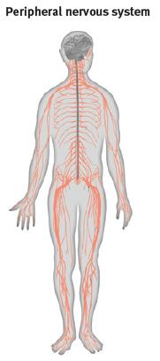
What is the __________ ________________(PNS) and what does it do?
The PNS is made up of sensory and motor neurons.
The PNS connects the body to the CNS by gathering information from the senses and transmitting messages from the CNS.

Slide 28
What are the two parts of the peripheral nervous system?
_____________
____________
controls the body’s
skeletal muscles
also called the skeletal nervous system
controls the glands
and the muscles of the internal organs
(such as the heart)
operates automatically

Slide 29
How is the autonomic division further broken down?
________________________________________
_______________________________________
arouses the body, mobilizing its energy
fight, flight or freeze
The gas pedal of a car.
calms the body,
conserving its energy
rest or digest
The brake pedal of a car.

Slide 30
How do the two parts of the central nervous system function?
____________
_________________
Comprised of the cortex and subcortical structures carrying out various functions
Nerves arranged into neural networks
Like people grouping in cities
2-way connection between PNS and brain
Oversees the sensory and motor pathways of reflexes.

Slide 31
How does a simple reflex occur?
A simple reflex ... like that to pain… occurs only in the spinal cord before information reaches the brain.

Slide 32
What is the ____________ system?
the body’s “slow”
chemical communication system;
a set of glands that secrete
hormones into the bloodstream

Slide 33
What is the difference between the nervous system and the endocrine system?
__________ system
___________ system
Neurons release neurotransmitters
Neurotransmitters move across synapses
Neural transmission is nano-fast
“text message”
Glands secrete hormones
Hormones move through the bloodstream
Hormonal secretion is slower
“email”

Slide 34
What is the _______________ gland?
The pituitary gland is the endocrine system’s most influential gland.
The hypothalamus directs the pituitary gland to regulate growth and control other endocrine glands.
The hypothalamus is part of both the CNS and the endocrine system.

Slide 35
How do scientists study the brain?
___________
______________
brain tissue is destroyed and researchers study the impact on functioning
Brain regions are stimulated electrically, chemically, or magnetically and researchers study the impact on functioning

Slide 36
How do EEG, MEG and CT scans image the brain?
______
A recording of the waves of electrical activity
across the brain’s surface measured by electrodes placed on the scalp.
______
A brain imaging technique that
measures magnetic fields from the
brain’s natural electrical activity.
____
_____
X-ray photographs taken from different angles and combined by computer to show
a slice of the brain’s structure; shows structural damage.

Slide 37
How do PET, MRI and fMRI scans image the brain?
_____
A visual display of brain activity that detects where a radioactive glucose goes while the brain performs a given task. Shows activity.
____
A technique that uses magnetic fields and radio waves to produce computer-generated images of brain anatomy.
More detailed than CT scan.
_____
A measure of blood flow and brain activity by comparing successive MRI scans to show brain function or as well as structure.
Shows damage.

Slide 38
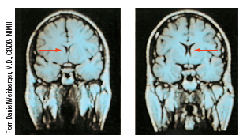
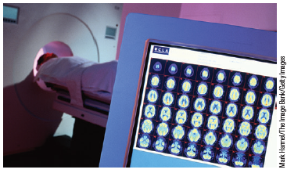
Which imaging techniques show structure and which indicate function?
These show the structures of the brain.
These indicate brain functioning.
_____________________
_____________________

Slide 39
Which structures make up the brainstem?

Slide 40
What are the functions of the ____________?
at the base of the brainstem
controls heartbeat and breathing

Slide 41
What are the functions of the ______?
just above the medulla
controls sleep and helps coordinate movements

Slide 42
What are the functions of the _______________?
nerve network that travels through the brainstem into the thalamus
helps control arousal and filters incoming sensory stimuli

Slide 43
What are the functions of the ____________?
at the top of the brainstem
relay station for incoming and outgoing sensory information (with the exception of smell)

Slide 44
What are the functions of the ____________?
at the rear of the brainstem
processing sensory
input, coordinating movement
and balance, nonverbal learning and memory

Slide 45
Which structures make up the ___________system?

Slide 46
What are the functions of the ____________?
two
lima-bean-sized neural clusters
linked to
emotion, fear, and aggression

Slide 47
What are the functions of the _____________?
below (hypo) the thalamus;
directs eating, drinking, body temperature
helps govern the
endocrine system via the pituitary gland, linked to emotion and reward

Slide 48
What are the functions of the ____________?
Small structure with two “arms” that wrap around the thalamus
helps process for storage explicit (conscious) memories of facts and
events

Slide 49
What is the _____________________?
The intricate fabric of
interconnected neural cells
covering the cerebral hemispheres;
the body’s ultimate control and
information-processing center.
It is divided into four regions called lobes.

Slide 50
What four lobes make up the cerebral cortex?
________________________________________
located in both right and left hemispheres

Slide 51
What are the functions of the frontal and parietal lobes?
__________ lobes
_________ lobes
Involved in speaking, motor movements, judgment and decision- making.
Receives and processes sensory input for touch and body position.

Slide 52
What are the functions of the temporal and occipital lobes?
__________lobes
________ lobes
Each lobe receives auditory information, primarily from opposite ear.
Each lobe receives visual information, primarily from opposite visual field.

Slide 53
What are the functions of the motor and somatosensory cortex?
________cortex
_______________ cortex
controls voluntary movements
registers information from the skin senses and body movement

Slide 54
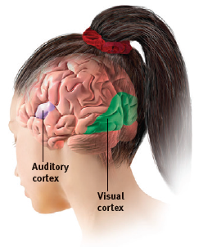
What are the functions of the auditory and visual cortex?
________ cortex
________ cortex
receives information from the ears
receives information from the eyes

Slide 55
What are the association areas?
Most of the brain’s cortex which integrates information involved in learning, remembering, thinking, and other higher-level functions.
Attention is shifted, planning occurs.
Not specifically devoted to motor or sensory cortex functions.

Slide 56
The case of _____________________
A tamping iron accident damaged neural tracks in his frontal lobe.
His frontal lobes could no longer filter emotional reactions from the limbic system.

Slide 57
What are Broca’s and Wernicke’s areas?
_____________ area
___________ area
language center located in the left frontal lobe
involved in expressive language
language center located in the left temporal lobe
involved in receptive language

Slide 58
How does our brain adjust to new experiences?
____________: the brain’s ability
to change, especially during childhood, by reorganizing after damage or by building new
pathways based on experience

Slide 59
What is __________________?
Although the brain often attempts self-repair by reorganizing existing tissue, it sometimes
attempts to mend itself through neurogenesis—producing new neurons.

Slide 60
What is meant by a ________________?
The corpus callosum is a wide band of axon fibers connecting the two hemispheres
of the brain.
Split brain results when the fibers of the corpus callosum are severed isolating each hemisphere
from the other.

Slide 61
What are a few differences in function between the left and right hemispheres?
__________hemisphere
__________ hemisphere
In most people:
speaking and language
math calculations
making literal interpretations
controlling the right side of the body
In most people:
perceptual tasks
making inferences
modulating speech
visual perception
recognition of emotion
controlling the left side of the body

Slide 62
What is _______________________?
The principle that information is often simultaneously processed on separate conscious and unconscious tracks. The two-track mind.
Perception, memory, thinking, language, and attitudes all operate on two levels—a conscious, deliberate
“high road” and an unconscious, automatic “low road.”
The high road is reflective, the low road intuitive.

Slide 63
What is __________?
A condition in which a person can respond to a visual stimulus without consciously experiencing it.

Slide 64
How does heredity differ from environment?
The genetic transfer of characteristics from parent to offspring.
heredity
(nature)
Every non-genetic
influence, from prenatal nutrition
to the people and things around us.
environment
(nurture)

Slide 65
What do __________________study?
Behavior geneticists study
the relative power and limits of heredity and environmental
influences on behavior.
The nurture of nature.
What comes built in, and what is nurtured—and how?

Slide 66
What is a ______________?
Threadlike
structures made of DNA molecules that contain the genes.
Each person has ___ chromosomes – you inherit ___from your mother and ____from your father.

Slide 67
What is ______?
DNA
(deoxyribonucleic acid)
is a complex molecule containing the
genetic information that makes up
the chromosomes.

Slide 68
What are ______?
The biochemical units
of heredity that make up the chromosomes;
segments of DNA
capable of synthesizing proteins.
You have ~20,000 genes.

Slide 69
How do ____________ twins develop?
Identical ___________ twins
a single
fertilized egg that splits in two,
creating two genetically identical
organisms

Slide 70
How do _____________ twins develop?
Fraternal dizygotic twins
separate fertilized eggs that share a maternal prenatal environment… no more alike than siblings

Slide 71
What do twins reared apart tell us about heredity and environment?
________________and his colleagues located and
studied 74 pairs of identical twins raised apart. They found similarities of tastes and physical attributes, personality, abilities, attitudes, interests, and even fears.

Slide 72
What is ________________?
The proportion of
variation among individuals in
a group that we can attribute to
genes.
The heritability of a trait
may vary, depending on the range
of populations and environments
studied.

Slide 73
What is _____________?
The study of environmental influences
on gene expression that occur
without a DNA change.
When we break down the word,
“epi” means above or in addition to.
So (epi) genetics studies how an individual’s lifestyle, environment, choices, etc. can directly interact with the genome.

Slide 74
How does epigenetics influence gene expression?
Beginning in the womb,
life experiences lay down
epigenetic marks—often
organic methyl molecules—that can affect the expression of any gene in the DNA segment
they affect.
(Research from Champagne, 2010.)

Slide 75
What is natural selection?
the principle that inherited traits that better
enable an organism to survive and reproduce in a particular environment will (in competition
with other trait variations) most likely be passed on to succeeding generations

Slide 76
What is a ____________?
a random error in gene
replication that leads to a change

Slide 77
What are ___________________?
a culturally modeled guide for how to act in
various situations
For instance, we have social scripts that tell us how to go out to eat in a restaurant (enter, take a seat, read a menu, order, eat, pay the bill, leave)
and social scripts that give indications of how men and women, elderly and young, etc., might act in a society.

Slide 78
What is the ___________________ approach to development?
Genes, environment and our culture all combine to influence our development.

